Slide 1
COVID-19 Statistics
28-07-2020

Slide 2
Latest Statistics
(updated 28-07-2020)
Total confirmed cases worldwide: 16,681,275
194,327 new cases (1% increase)
Total fatal cases worldwide: 659,359
5,319 new fatalities (0% increase)
Israel recorded 66,293 cases in total
increased by 2,308 cases (3% increase)
36.0# in confirmed cases, 56.0# in mortality
20.0# in cases per capita, 57.0# in mortality rate

Slide 3
Latest Statistics
(updated 28-07-2020)
Worldwide mortality rate: 4.0% (-0.0%)
Israel mortality rate: 0.7% (-0.0%)
US has most cases in total (4,351,997)
US has most fatal cases in total (US)
US recorded the most new cases (61,660)
US recorded the most new fatal cases (1,244)

Slide 4
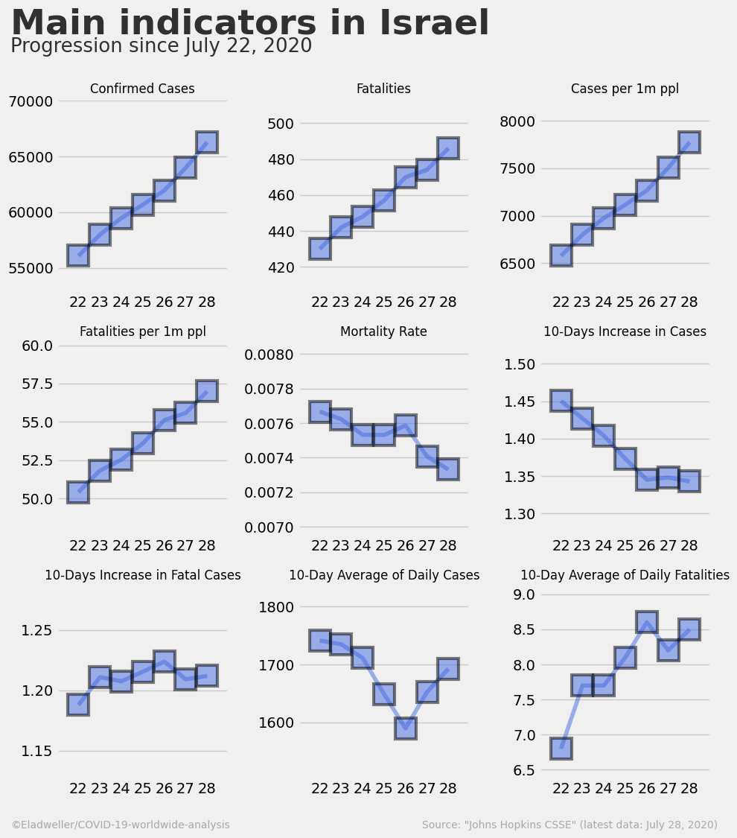

Slide 5
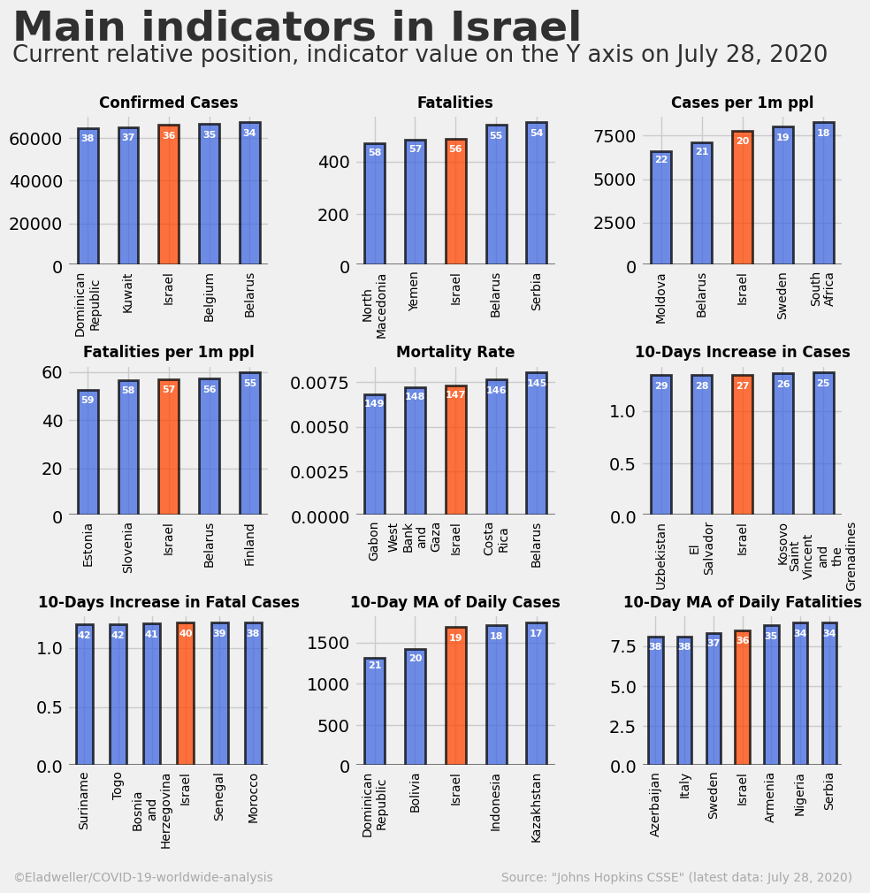

Slide 6
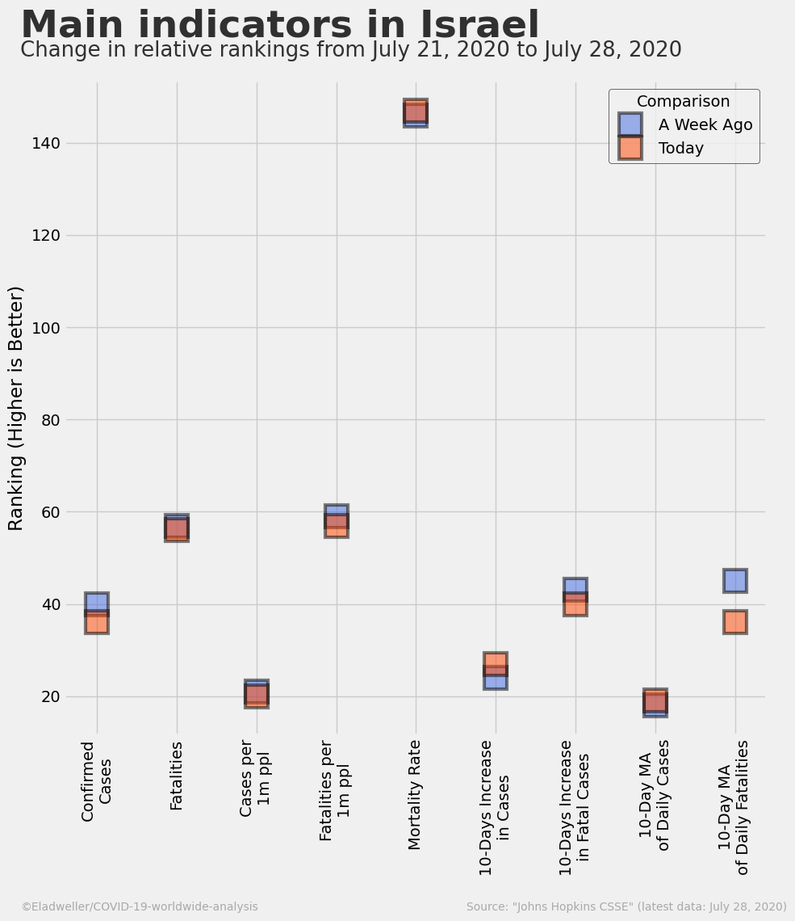

Slide 7
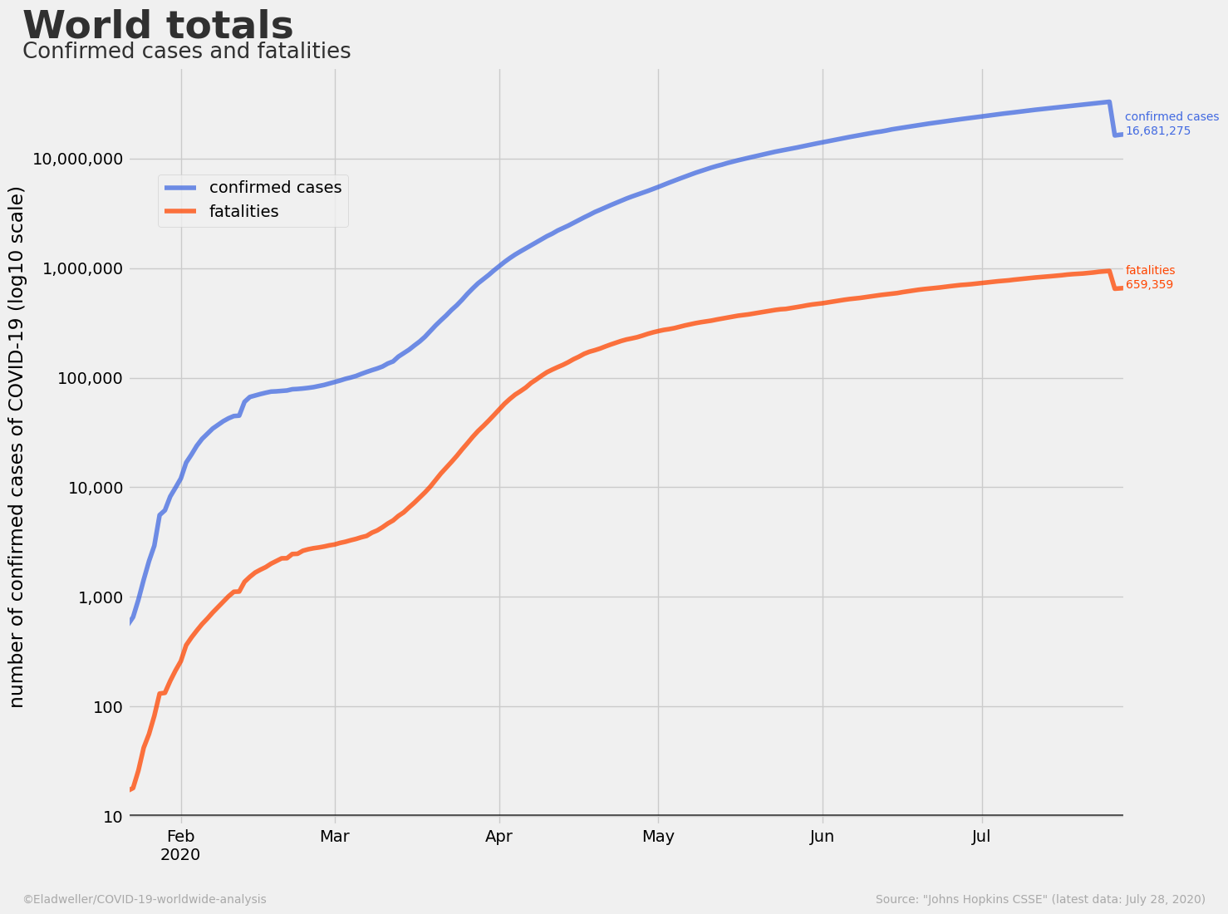

Slide 8
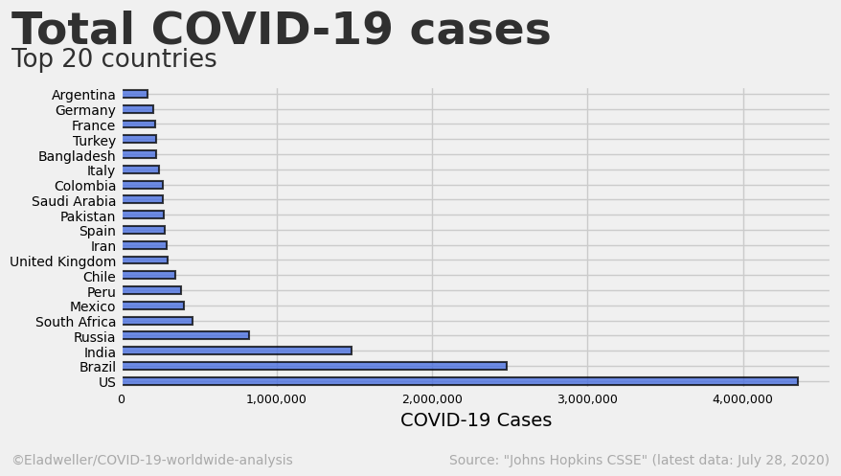

Slide 9
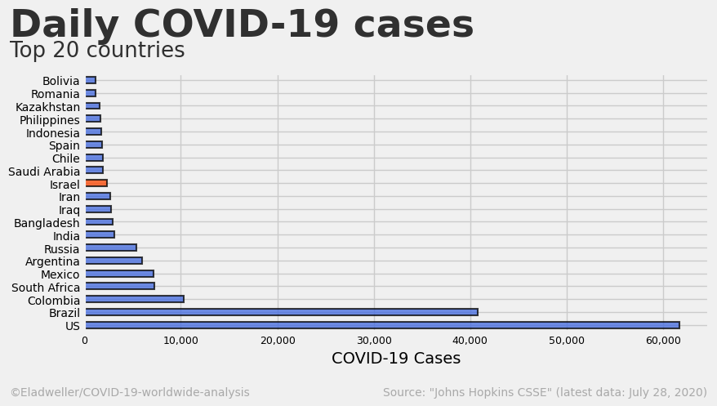

Slide 14
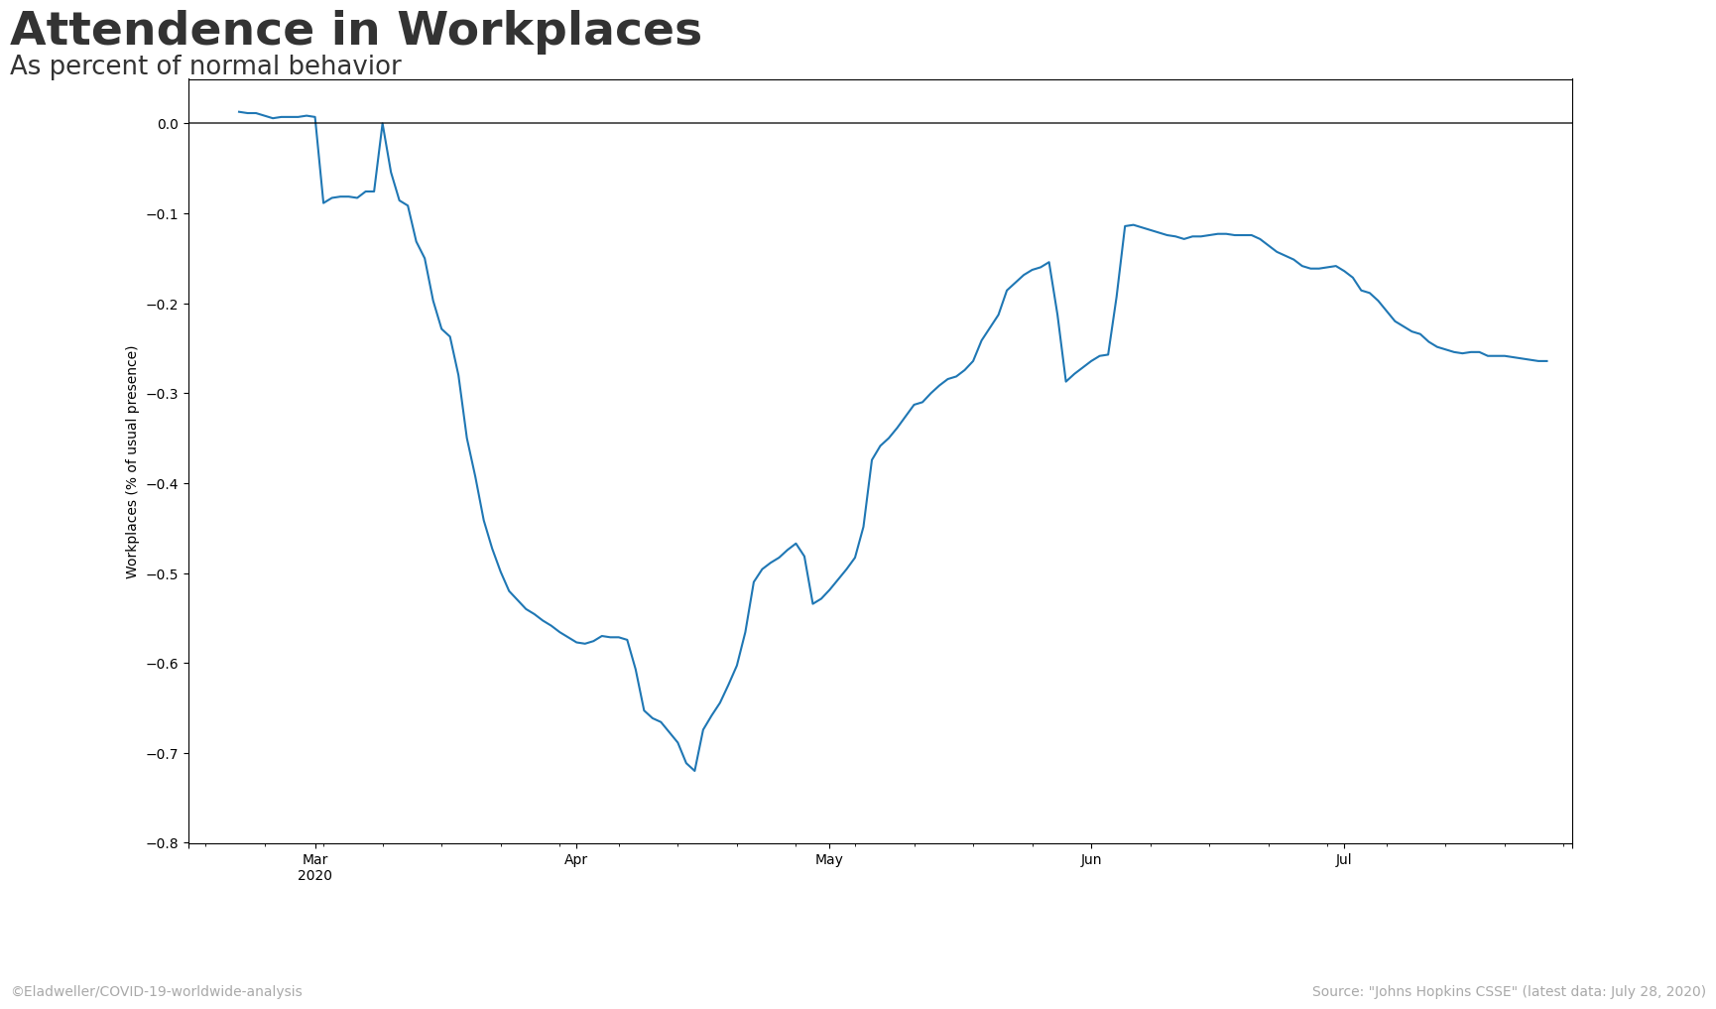

Slide 15
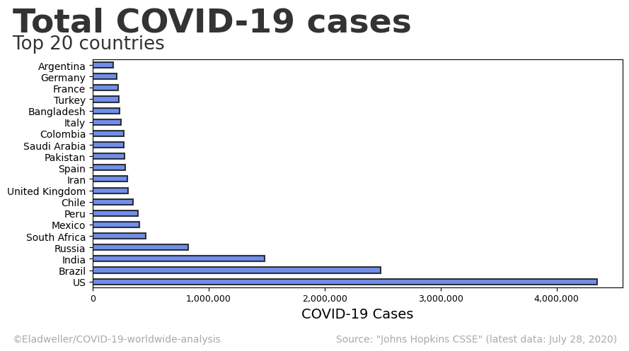

Slide 16
